Slide 1
Apple I phone sales analysis
Mini Project by
Ravivarma
Guide: Urooj khan
scifor technologies

Slide 2
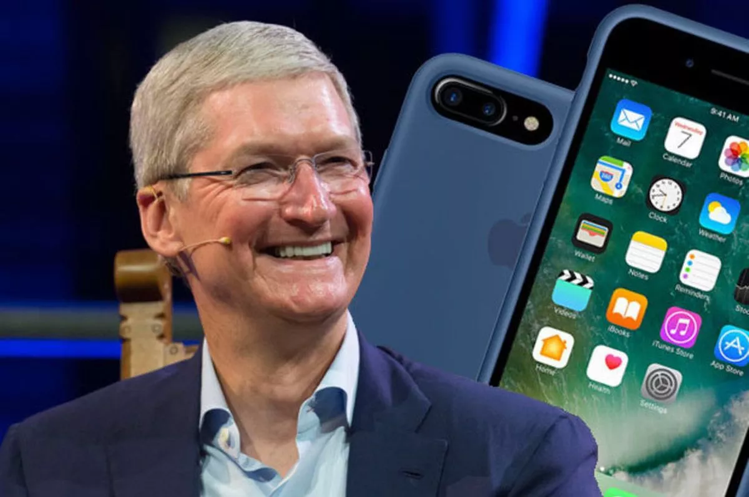
CEO of Apple company: Tim Cook

Slide 3
Apple I phone sales analysis
The Indian smartphone market has witnessed exponential growth over the past decade
As one of the world’s largest and most diverse markets, understanding the dynamics of iPhone sales in India is crucial for both Apple and investors, with a significant surge in iPhone sales.
in this article, we will explore how Python, a powerful programming language, can be utilized to conduct a comprehensive analysis of iPhone sales data, helping us gain valuable insights into consumer preferences, market trends, and potential growth opportunities.

Slide 4
Apple I phone sales analysis
To conduct a comprehensive analysis of iPhone sales in the Indian market, lets use this well-curated dataset from Kaggle.
This dataset contains valuable information about the sales of iPhones in India & with this rich dataset at our disposal, we can delve into the data and extract meaningful insights into consumer behavior, market trends, and potential growth opportunities.
Once the dataset is downloaded, we will install the necessary libraries for analysis

Slide 5
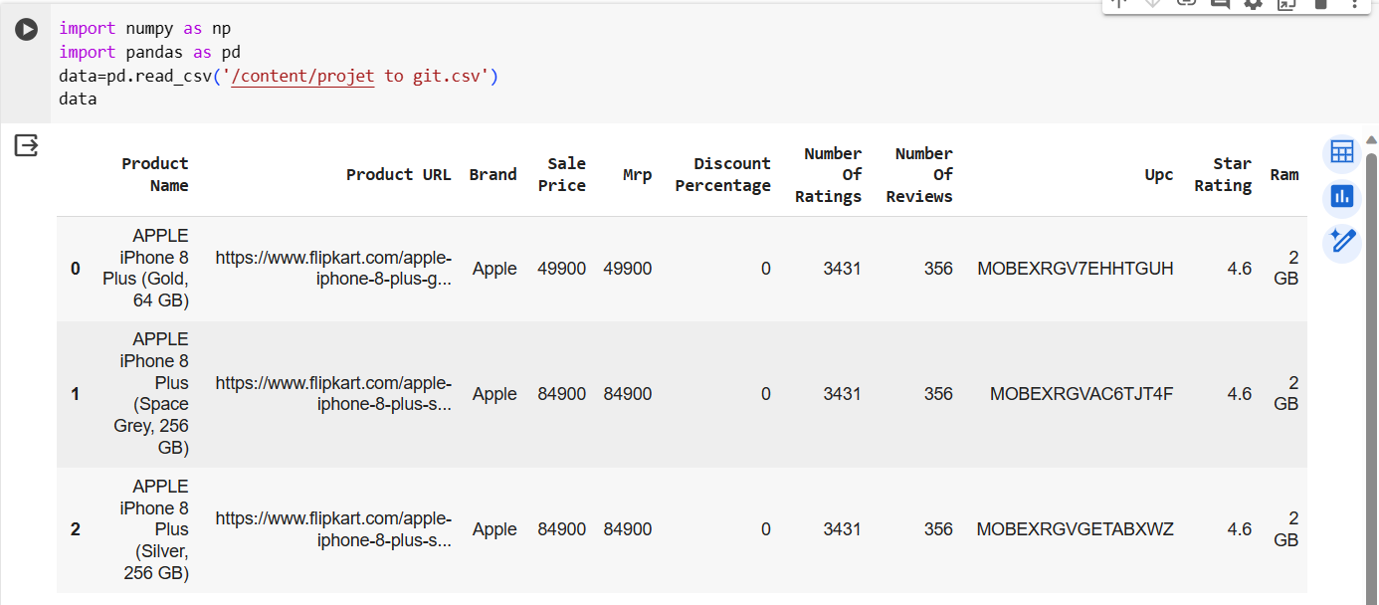
import numpy as np import pandas as pd import plotly.express as px import plotly.graph_objects as go data=pd.read_csv('/content/projet to git.csv') data

Slide 6
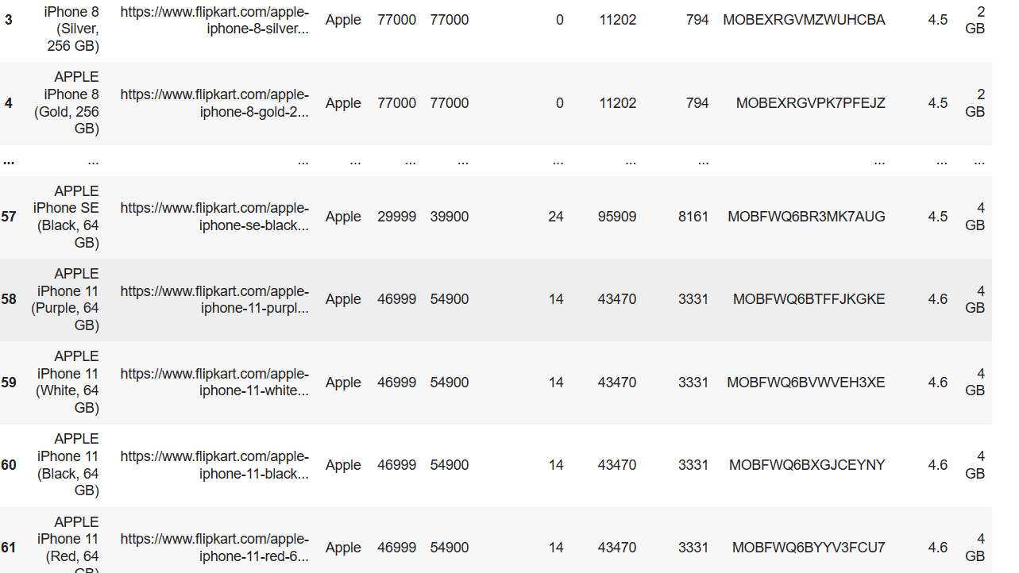
output

Slide 7
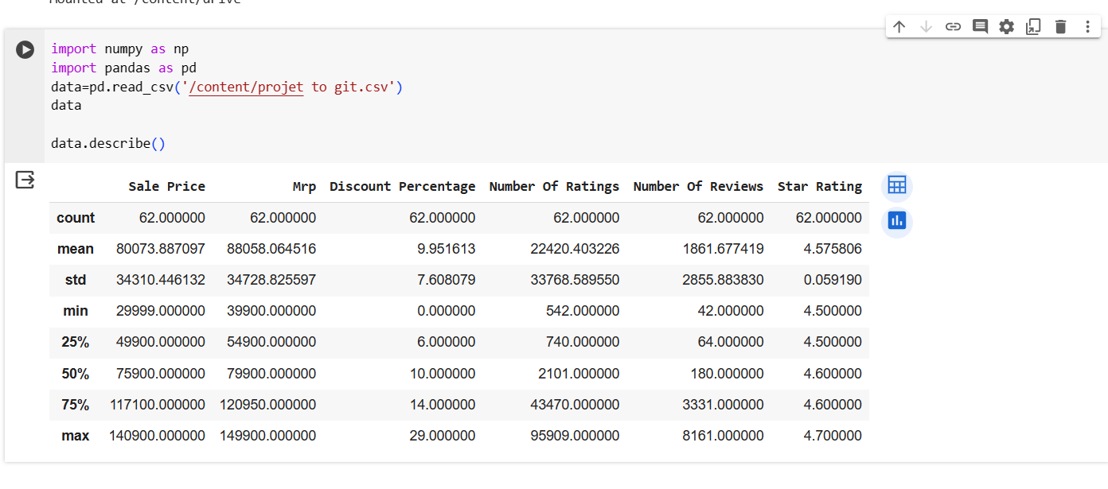
data.describe()

Slide 8
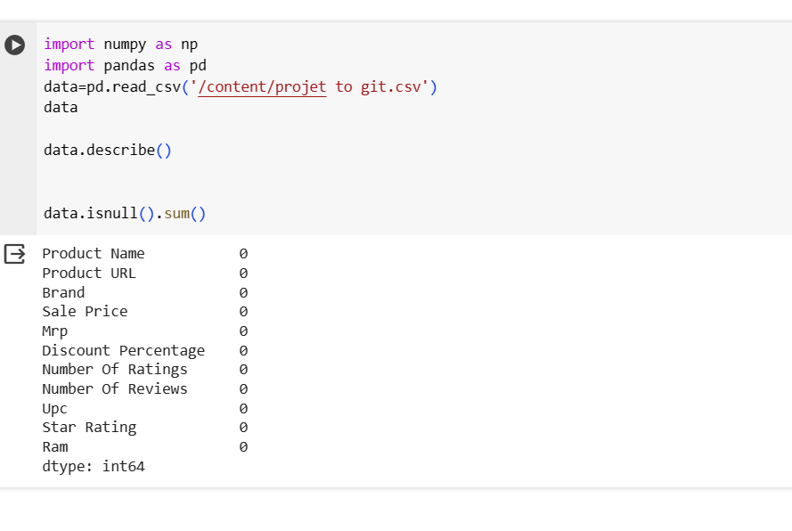
data.isnull().sum()

Slide 9
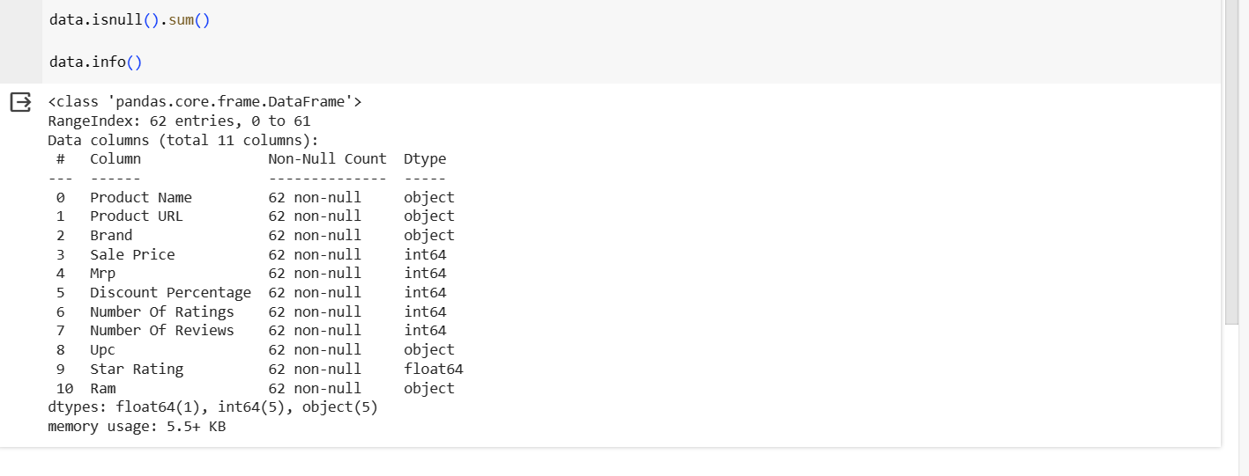
data.info()

Slide 10
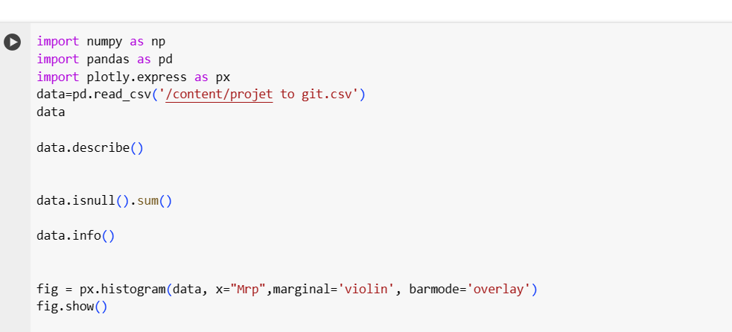
fig = px.histogram(data, x="Mrp",marginal='violin', barmode='overlay') fig.show()

Slide 11
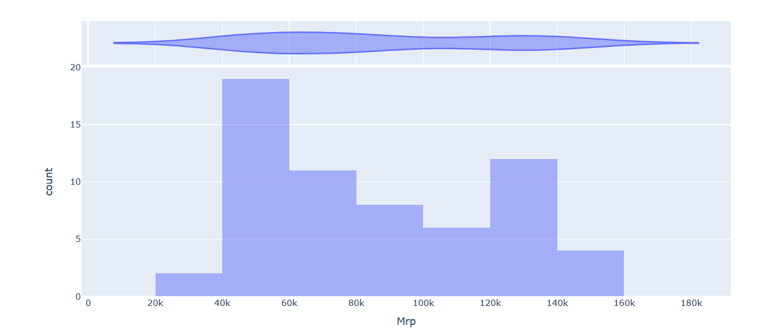
Out put

Slide 12
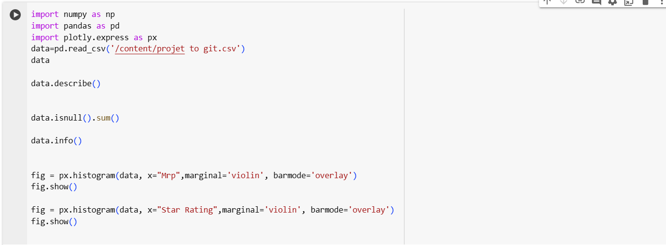
highest_rated=data.sort_values(by=["Star Rating"] ,ascending=False).head(10) highest_rated["Product URL"]

Slide 13
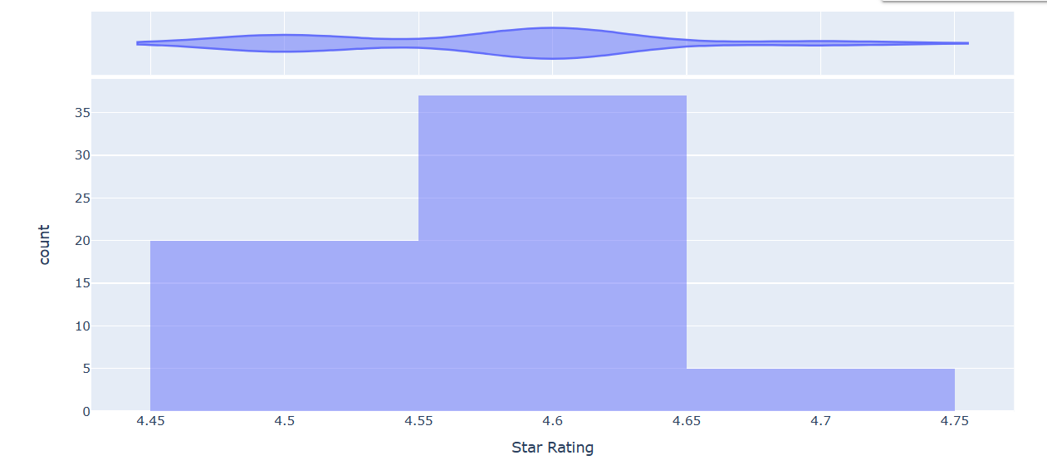
output

Slide 14
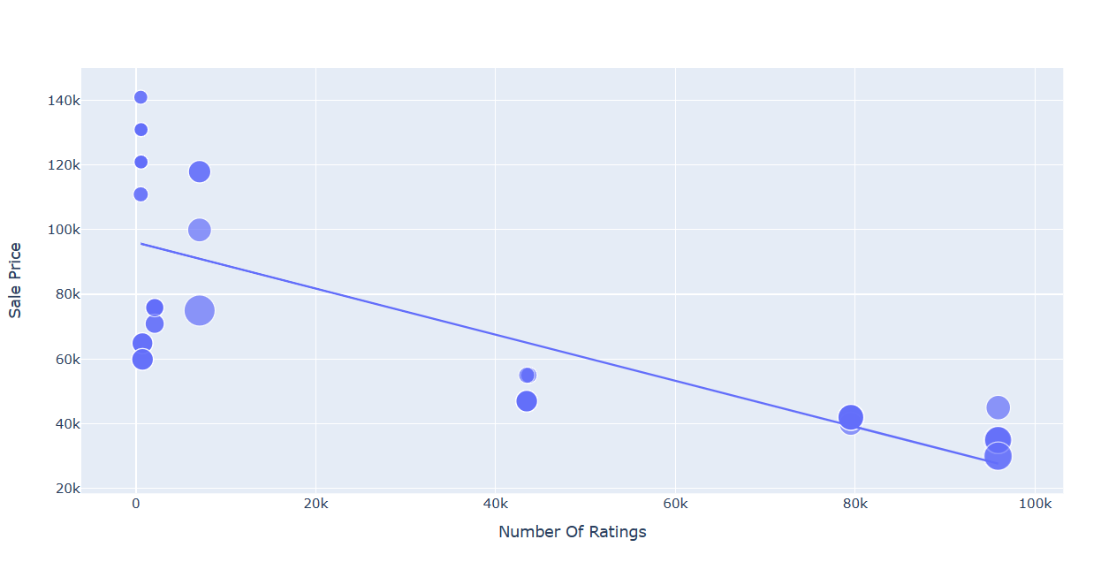
fig=px.scatter(data_frame=data,x="Number Of Ratings",y="Sale Price",size="Discount Percentage",trendline="ols") fig.show()

Slide 15
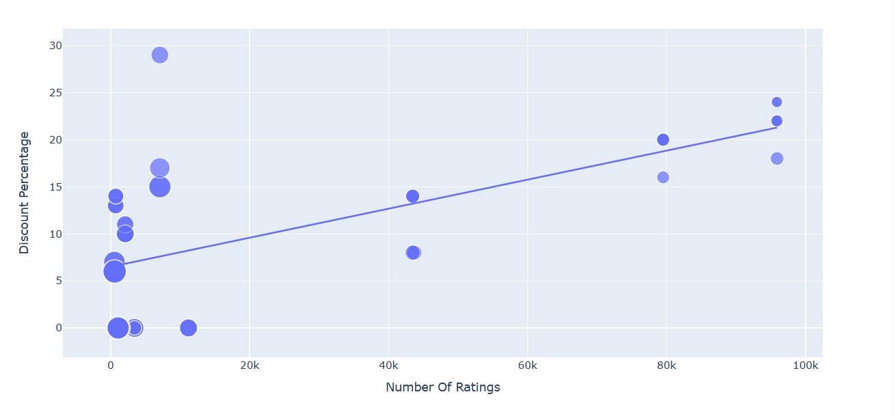
fig=px.scatter(data_frame=data,x="Number Of Ratings",y="Discount Percentage",size="Sale Price",trendline="ols") fig.show()

Slide 16
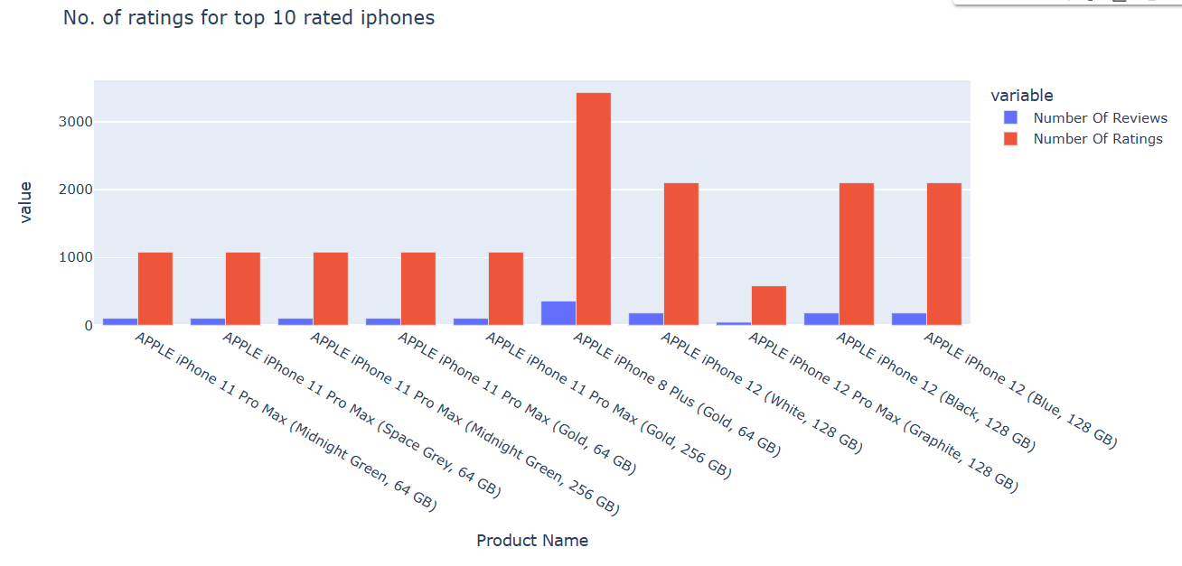
labels=highest_rated['Product Name'] count=highest_rated['Number Of Ratings'] fig=px.bar(highest_rated,x=labels,y=[highest_rated['Number Of Reviews'],count],barmode='group',title="No. of ratings for top 10 rated iphones") fig.show()

Slide 17
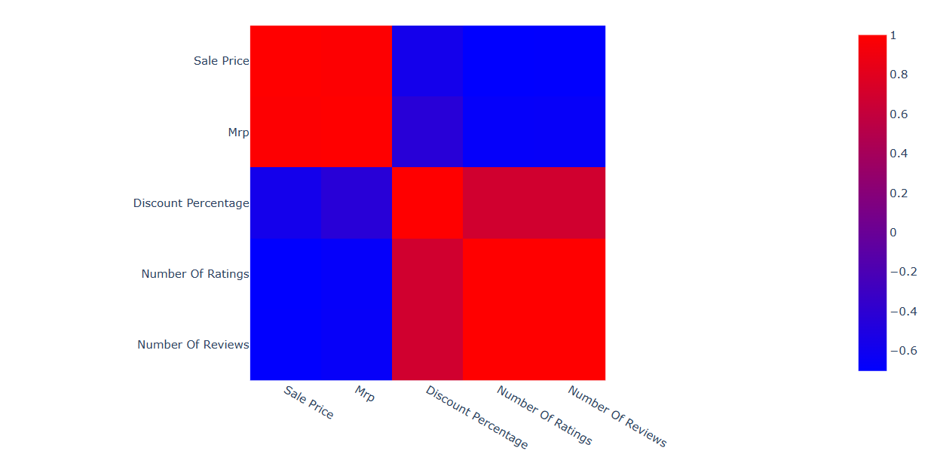
fig = px.imshow(corelation,color_continuous_scale='Bluered') fig.show()

